Slide 1
Optimization
Chapter # 7
Applied numerical analysis by Gerald

Slide 2
A firm manufactures two products A and B on which the profits earned per unit are Rs. 3 and Rs 4 respectively. Each product is processed on two machines M1 and M2. Product A requires 1 minute of processing time on M1 and 2 minutes on M2 while B requires 1 minute on M1 and 1 minute on M2. Machine M1 is available for not more than 7 hours 30 minutes. While machine M2 is available for 10 hours during any working day. Find the number of units of products A and B to be manufactured to get maximum profit.
Formulation of linear programming Model
Let 𝑥 𝑎𝑛𝑑 𝑦 denote the number of units of product A and B
Objective is to maximize the profit
Z= 3𝑥 + 4𝑦
Subject to,
Time available for M1 𝑥 + 𝑦 ≤ 450
Time available for M2 2𝑥 + 𝑦 ≤600
𝑥, 𝑦 ≥ 0

Slide 3
Find the maximum value of Z= 2𝑥 + 3𝑦 Subject to, 𝑥 + 𝑦 ≤ 30 𝑦 ≥ 3 𝑦 ≤12 𝑥 − 𝑦 ≥ 0 0 ≤ 𝑥 ≤ 20 𝑥, 𝑦 ≥ 0

Slide 4
Objective is to maximize function Z= 𝑥₁ + 2 𝑥₂
-𝑥₁ + 2 𝑥₂ ≤ 8
𝑥₁ + 2 𝑥₂ ≤ 12
𝑥₁ - 2 𝑥₂ ≤ 3
𝑥₁ , 𝑥₂ ≥0

Slide 5
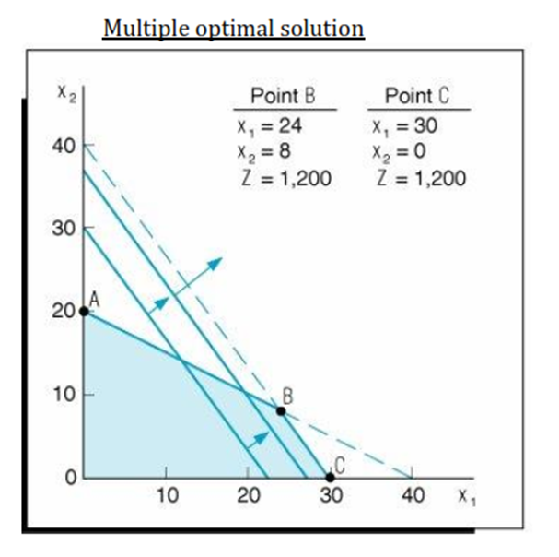

Slide 6
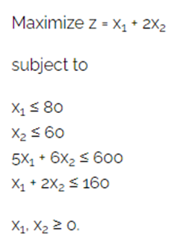
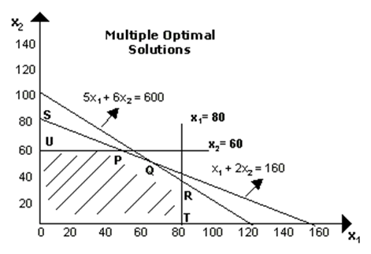

Slide 7
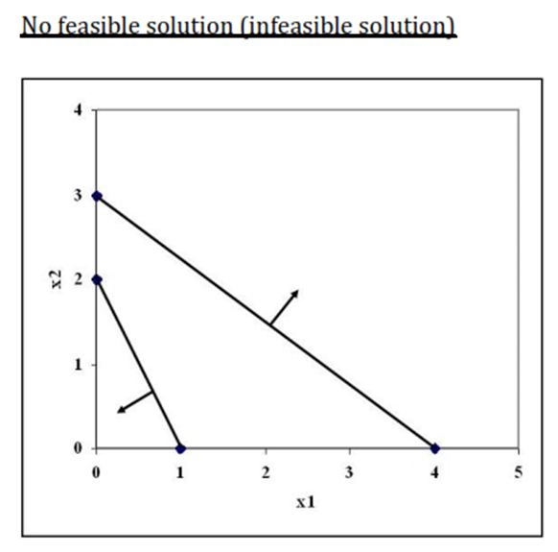

Slide 8
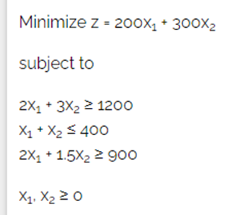
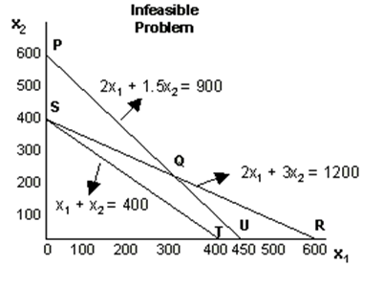

Slide 9
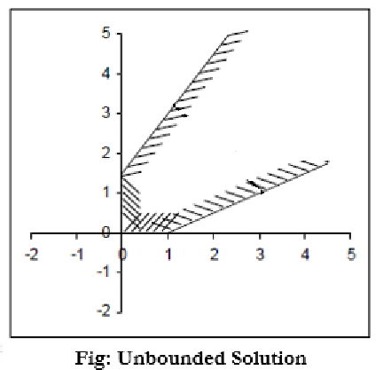

Slide 10
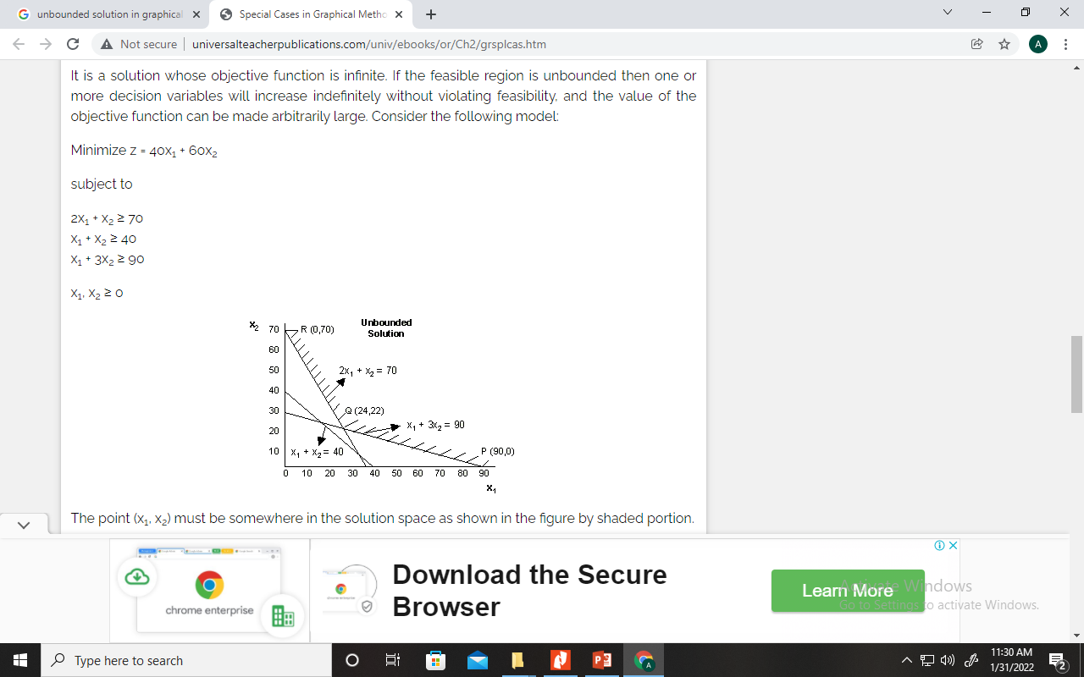

Slide 11
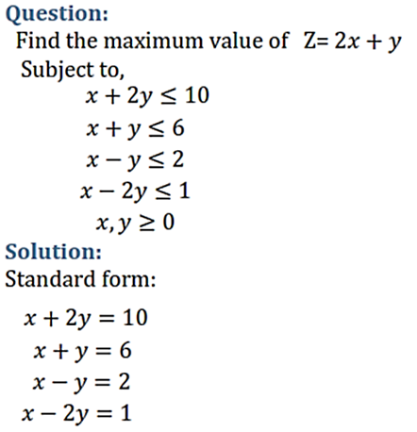
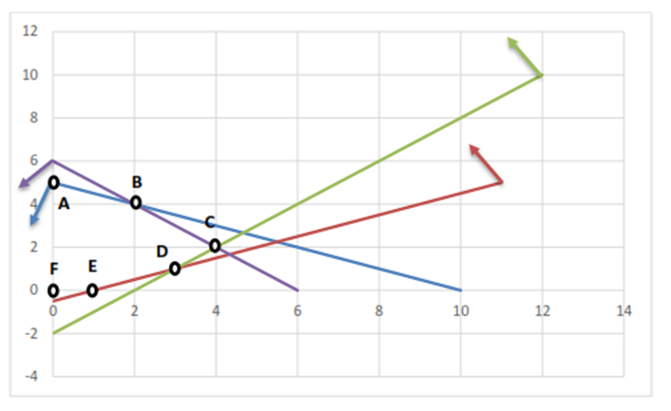
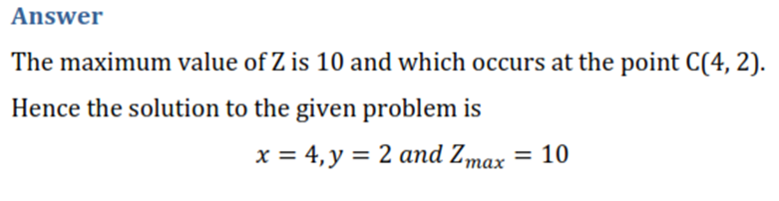

Slide 12
